Slide 1
Correlation

Slide 2
Descriptive Statistics
Summary of the measure of the characteristics of individuals in groups.
A descriptive statistic talks about a single characteristics within a given group. Lots of descriptive statistics are summarizing lots of characteristics but all within a given group.
Another way to describe the group then would be to talk about the relationship of the descriptive statistics to each other.

Slide 3
Examining Relationships
One way to examine the relationship among measures might be to see if they measures of two variables changed in similar ways.
You measure age and interest in watching Sarah and Duck.
You see a correlation between the measures: the younger a person is the more interested they are in watching the show.
You now have another way to describe the group you are studying.

Slide 4
Descriptive Correlations
“In the group I examined, people are more likely to be interested in watching Sarah and Duck the younger they are.”
Formally: Correlation is the measure of the degree of correspondence between two or more variables

Slide 5
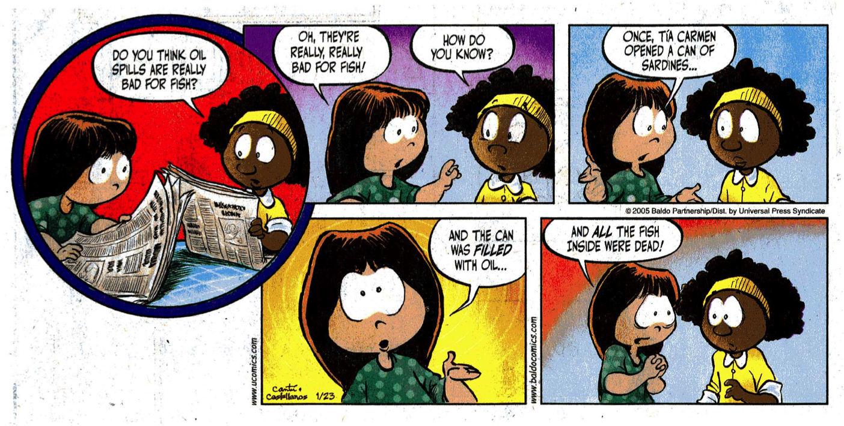
Correlation: Measure of the degree of correspondence between two or more variables
Oh, they’re really, really bad for fish!
How do you know?
Once, Tia Carmen opened a can of sardines…
Do you think
oil spills are really bad for fish?
And all the fish inside were dead!
And the can was filled with oil…
0

Slide 6
Measuring Variable Relationships
Students with more referrals have lower GPAs.
Variables
Referrals and grade point average
How strongly are these two variables linked?
How about if someone said: Middle school students who dress poorly come from lower SES families.

Slide 7
Measuring Variable Relationships
The reason you are more confident about referrals and GPA is that the two variables are more closely related than dress and SES.
It is harder to think of examples where referrals and GPA would not be related.
When two variables show this strong association, they have a high or strong correlation.

Slide 8
Measuring Variable Relationships
How about the relationship of hearing loss and age in men?
There is probably a strong correlation between these two variables.
The relationship is strong and directionally the same.

Slide 9
Measuring Variable Relationships
Age and hearing loss:
more hearing loss/higher age
less hearing loss/lower age
Referrals and GPA:
fewer referrals/higher GPA
more referrals/lower GPA
These sets of variables may have the same strength of association but they are linked in opposite directions.

Slide 10
Correlation Coefficient
A single number that represents the strength and direction of a relationship between two variables within the same sample.

Slide 11
Correlation

Slide 12
Correlation—Positive
Ray
Years of Teaching
Megan
Age

Slide 13
Correlation—Positive
Years of Teaching
Age

Slide 14
Correlation—Positive
.88
Years of Teaching
Age

Slide 15
Correlation—Negative
-0.71
Sick Leave Days
Years of Teaching

Slide 16
Correlation—Negative
-.71
Sick Leave Days
Years of Teaching

Slide 17
Correlation

Slide 18
Correlation—None
Class Size
-.07
Sick Leave Days

Slide 19
Correlation Practice

Slide 20
Correlation Range
-1.0
-.7
-.3
0
.3
.7
1.0
Variables change in opposite directions
Variables change in the same direction
No Correlation
High
Moderate
Low or Weak
Moderate
High

Slide 21
Correlation Questions
How close are two variables to having a linear relationship with each other?
How well does one variable describe another?
How far are the points in a scatter plot from the best fit line?
Does it help to describe a group by talking about the strength of the relationship between variables?

Slide 22
Correlation Practice
Download Pinecrest Data
Produce scatterplots and correlations for all of the tests and GPAs (all 5).
Correlation matrix
What do you know?

Slide 23
Reporting Correlations
In the results section list the sample size, two variables compared and the two decimal point correlation number.
“In the comparison of number of referrals and gpa for 36 students the correlation was .73.”
Do not make a correlation table unless you have more than two variables that are being compared.

Slide 24
Correlation Table
 | Var1 | Var2 | Var3 | Var4
Var1 | 1 | 0.67 | 0.32 | -0.44
Var2 | 0.67 | 1 | -0.02 | 0.67
Var3 | 0.32 | -0.02 | 1 | 0.32
Var4 | -0.44 | 0.67 | 0.32 | 1

Slide 25
Correlation Table
 | Var1 | Var2 | Var3 | Var4
Var1 |  | 0.67 | 0.32 | -0.44
Var2 | 0.67 |  | -0.02 | 0.67
Var3 | 0.32 | -0.02 |  | 0.32
Var4 | -0.44 | 0.67 | 0.32

Slide 26
Correlation Table
 | Var1 | Var2 | Var3 | Var4
Var1
Var2 | 0.67
Var3 | 0.32 | -0.02
Var4 | -0.44 | 0.67 | 0.32

Slide 27
Correlation Table
 | Var1 | Var2 | Var3
Var1
Var2 | 0.67
Var3 | 0.32 | -0.02
Var4 | -0.44 | 0.67 | 0.32

Slide 28
Correlation Table
 | Var1 | Var2 | Var3
Var2 | 0.67
Var3 | 0.32 | -0.02
Var4 | -0.44 | 0.67 | 0.32

Slide 29
Correlation Table

Slide 30
APA Tables
An informative table supplements—rather than duplicates—the text. (section 5.10)
Tables should be integral to the text but should be designed so that they can be understood in isolation. (section 5.07)
Be selective in choosing how many graphical elements to include in your paper. … Information that used to be routinely presented in tables is now routinely presented in text. (section 5.03)

Slide 31
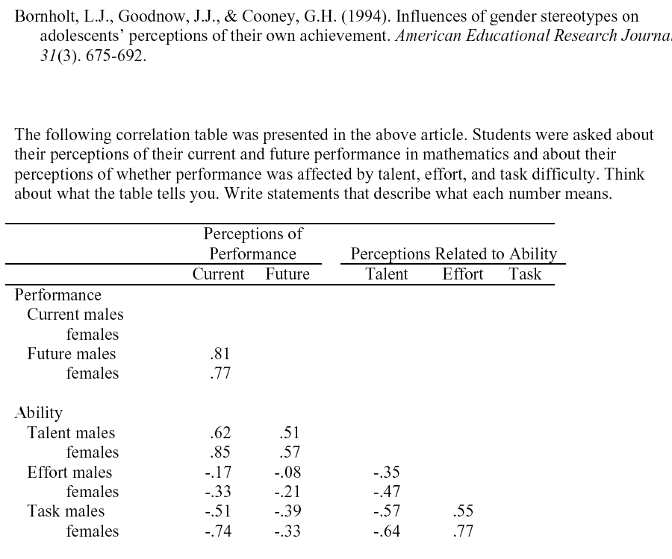
l.
Current Performance—How well do you think you will do in math this year? (Not at all well - Very well) Future Perfor.—How well do you think you will do in math in senior high? (Not at all well - Very well) Talent—Do you perceive yourself to be talented in math? (Not at all - Quite a lot) Effort—How hard do you have to try to get good marks in math? (Little - A lot) Task—In general, how hard is math for you? (Very easy - Very hard)

Slide 32
Correlation Caution
As ice cream sales increase so do drowning deaths.
Any two sets of numbers can be correlated.
Sometimes there are one or more intervening variables that explain the relationship.

Slide 33
Correlation Caution
In general students who are more motivated have better GPAs.
More motivated—higher grades; Less motivated—lower grades.
We do not know that motivation causes improved performance or that performance causes motivation. Maybe neither causes the other.

Slide 34
In a study of the influence of teachers on student achievement, researchers discovered a correlation of .78 between the age of students’ last math teacher and their score on the math portion of the SAT. Apparently older teachers give students better content or skills for doing well on these tests than their younger counterparts.
Correlations are not causation. Look for alternative explanations.

Slide 35
In the late 1960s a Stanford researcher was investigating sunspots. He noticed quite accidentally that during times of higher sunspot activity that Beatles’ songs seem to be playing more frequently on the radio in his lab. He did an analysis and discovered a .67 (moderate to high) correlation between sunspot activity and Beatles recordings position on the charts.
Correlations need to make sense. There needs to be a reason to believe that a relationship exists between variables independent of the calculation of the correlation. Where is the literature?

Slide 36
Excel

